Slide 1
Know your car

Slide 2






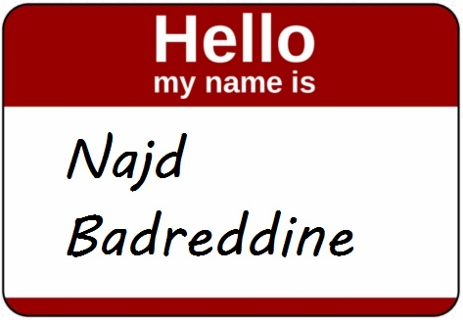

Team Problem Solution Ai integration Demo
Outline:

Slide 3
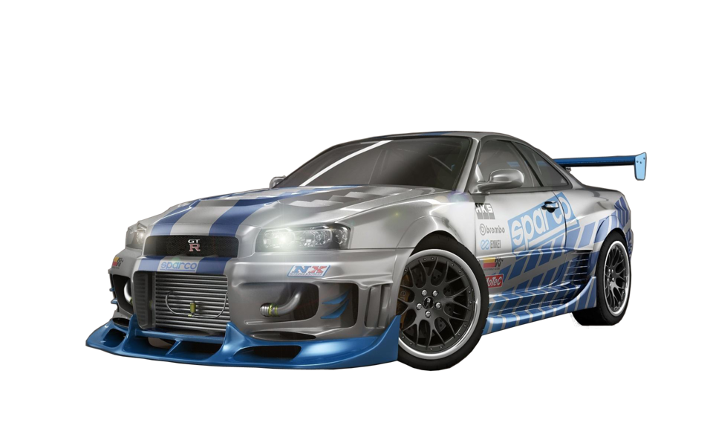
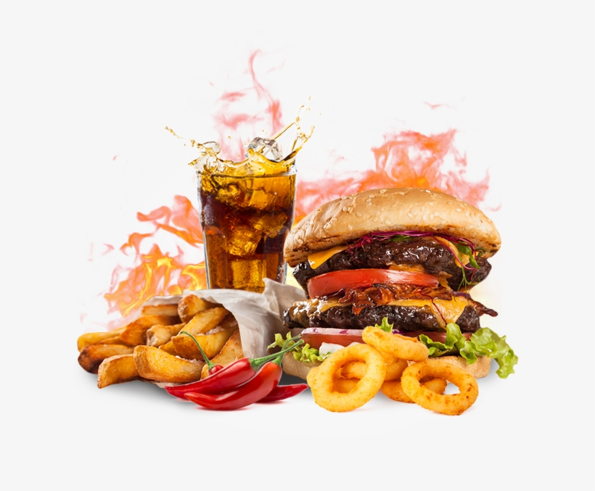


Team Problem Solution Ai integration Demo
Outline:
Notes:
Most of Lebanese teenagers are interested in 2 main things, food and fast cars (here comes the name of our team fat and furious). They tend to edit and upgrade their cars to get a better speed and performance

Slide 4
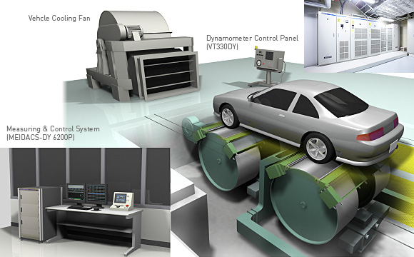
Team Problem Solution Ai integration Demo
Outline:
Notes:
However to know the new performance of their car they need to take it to a professional garage and use a car dynamometer to know the new horsepower of their car. This process is really expensive. The dynamometer cost around 35 000$, the test cost is between 400-700$

Slide 5




Team Problem Solution Ai integration Demo
Outline:
Notes:
The solution is in finding a analytic way to find the new performance of the new car. So calculating and finding car's parameters that may affect its performance manifested in its horsepower. Parameters such as cylinders, wheelbase and aspiration.

Slide 6
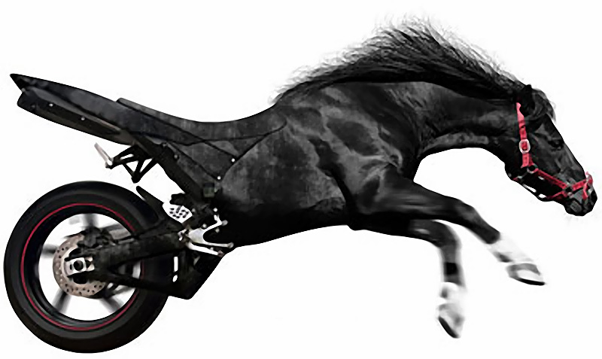
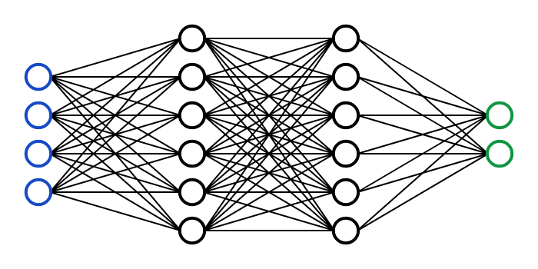
Team Problem Solution Ai integration Demo
Outline:
Notes:
A neuro network system that processes the car's features parameters to calculate and determine its horsepower. Therefore any edit on the car therefore on those parameters will force a change in the horsepower

Slide 7


Team Problem Solution Ai integration Demo
Outline:

Slide 8
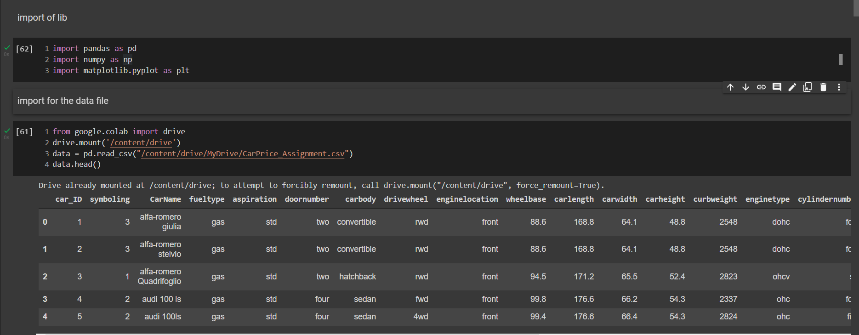
1- Importing data
Notes:
Our dataset of size 205 model was originally formed of 25 columns

Slide 9
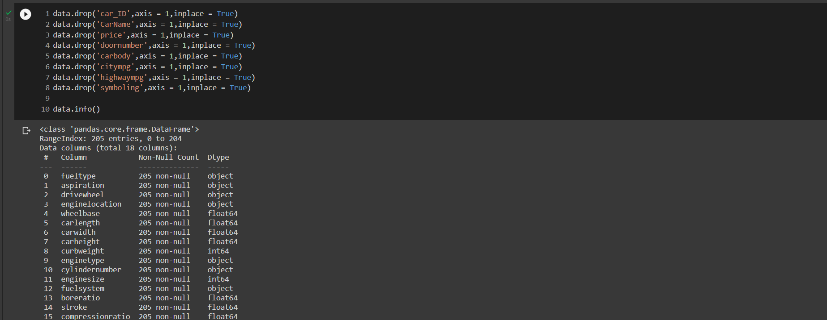
2- Dropping columns
Notes:
We started by cleaning our dataset by dropping unuseful columns.

Slide 10
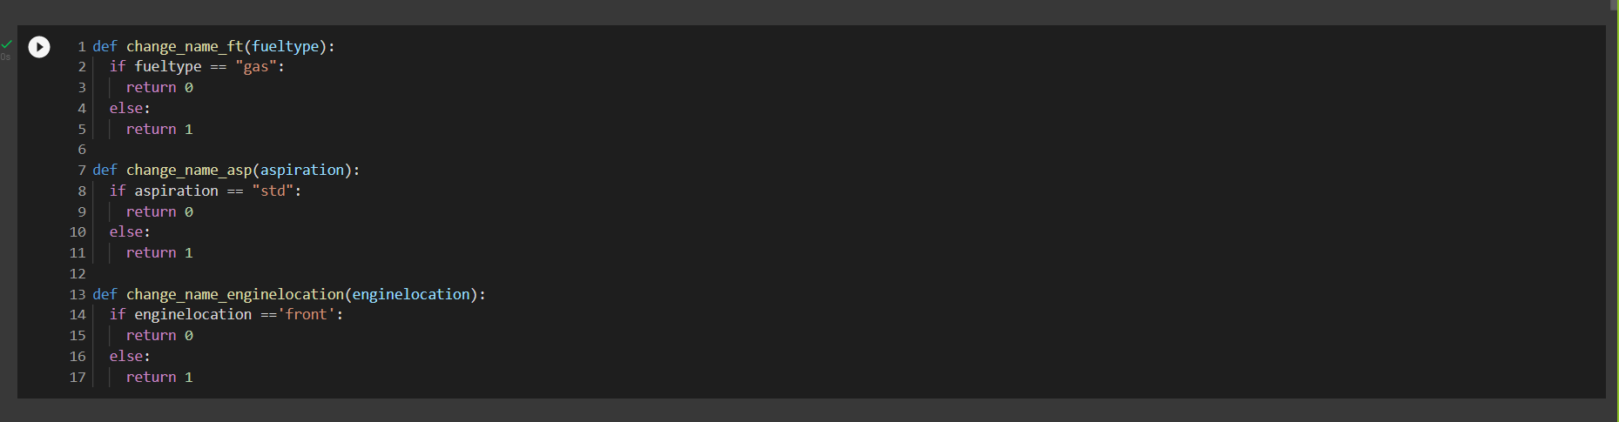
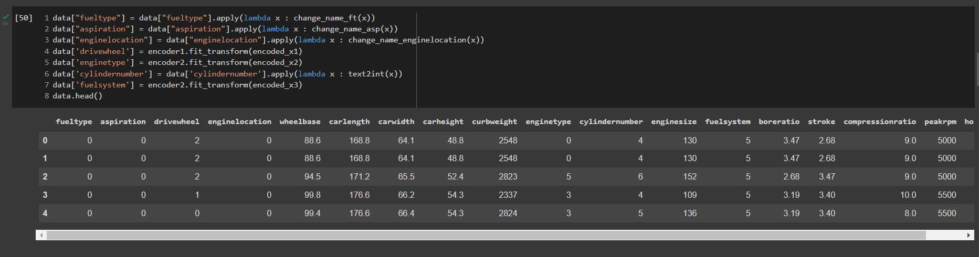
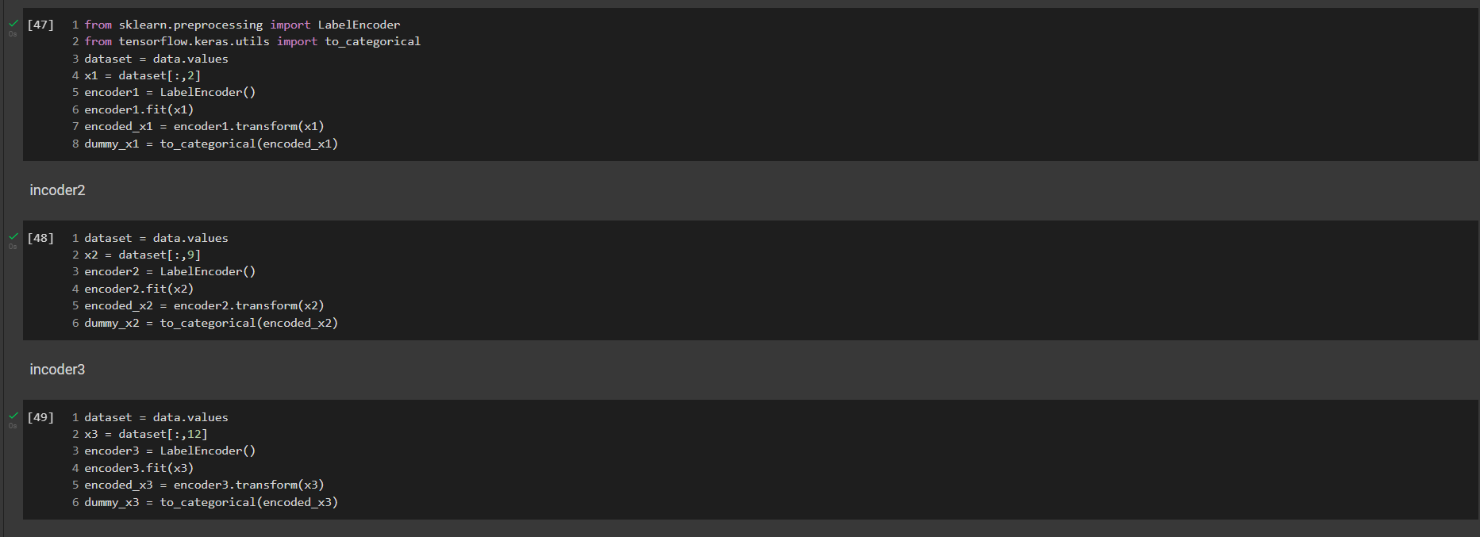
3-Changing data types.
Notes:
We relized that each parameter has a different type therefore we implemented replacers and one-hot incoders to change our data

Slide 11
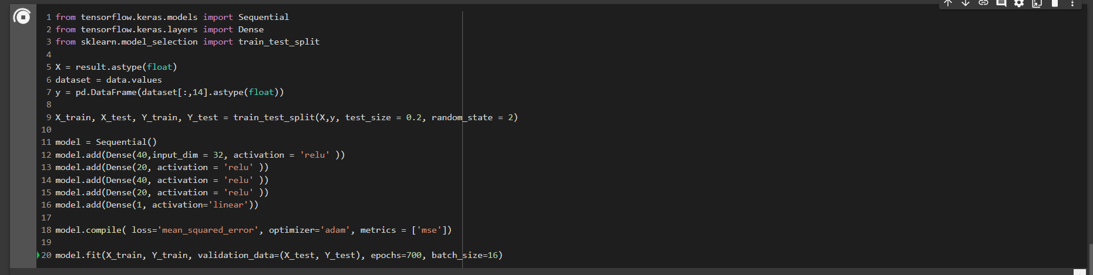
4-Model training
Notes:
We started by dividing our data into training and testing variable and chose mean squared error to check how close our testing model is to the training variable.
At first our model was underfit so we had to implement new hidden layers, and we chose a higher epochs because our dataset is relatively small.

Slide 12
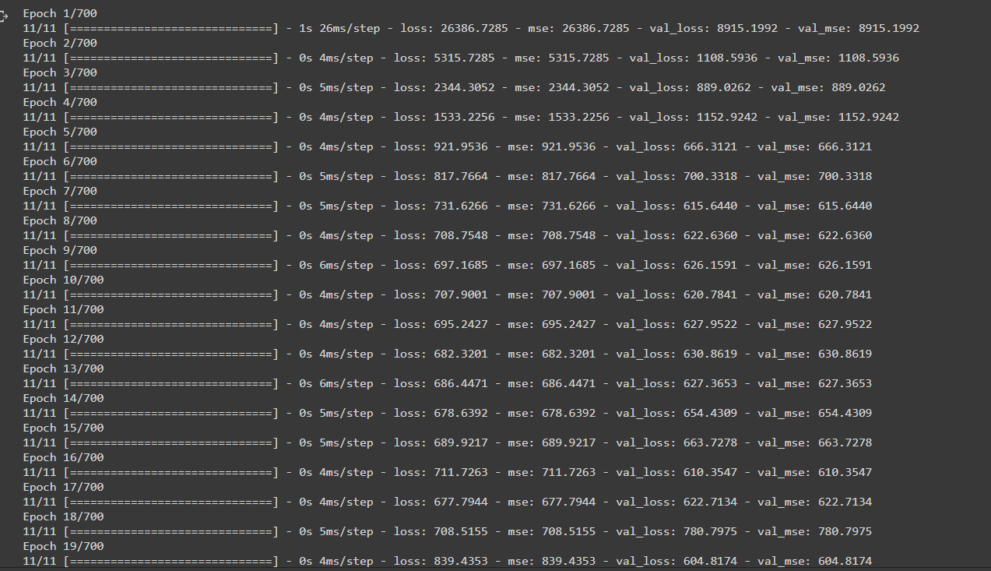
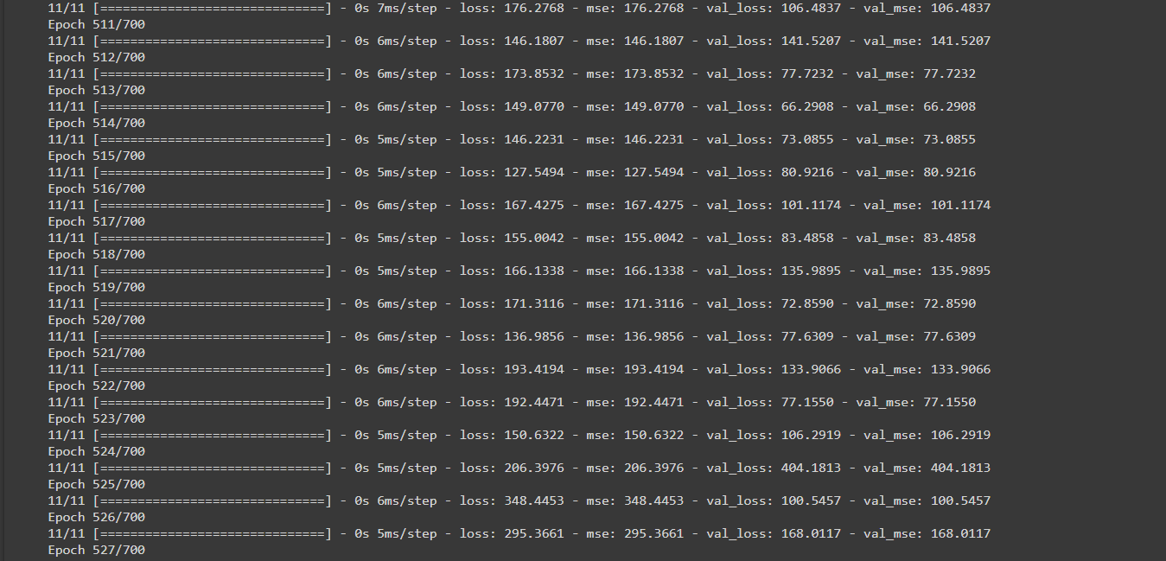
5-Model Summary
Notes:
After training our model we founf that the mean squared error was decreasing gradually.. In fact,

Slide 13
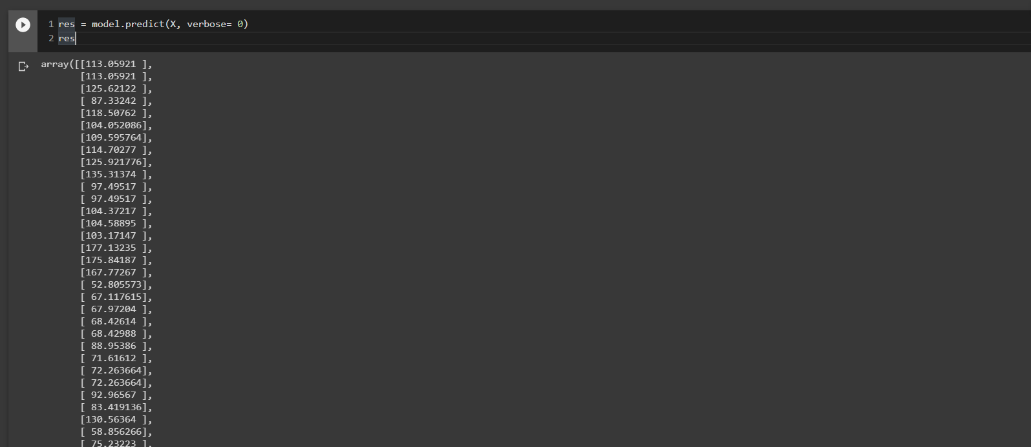
6-Making prediction.
Notes:
In the end we used model.predict to check our model. In comparison with our dataset we found that the model has a marge of error maximum 15%.. In the future this marge will get smaller when adding more data

Slide 14


Any Questions

